Slide 1

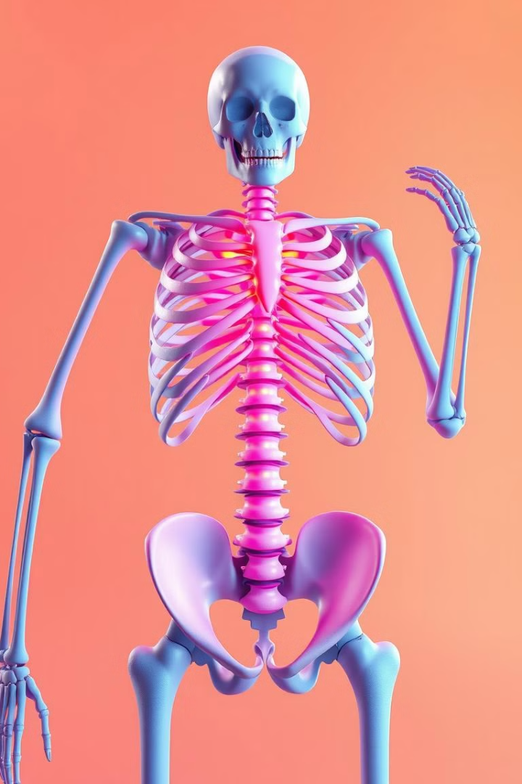
Osteoporosis Risk Prediction Project
Osteoporosis is a silent disease that weakens bones, increasing the risk of fractures and long-term health complications. This project focuses on developing a machine learning model to predict osteoporosis risk based on patient attributes such as age, gender, lifestyle habits (smoking, alcohol consumption, physical activity), medical history, and dietary factors (calcium and vitamin D intake).
by Dinal Pandya
DP

Slide 2
INTRODUCTION:
OBJECTIVE
IMPORTENCE
The objective of this project is to develop an accurate osteoporosis risk prediction model based on patient attributes such as age, lifestyle habits, medical history, and dietary intake. This predictive approach enables early detection, supports healthcare professionals in decision-making, and helps in designing personalized treatment and prevention strategies to reduce osteoporosis-related complications.
The importance of an osteoporosis risk prediction project lies in its ability to enable early diagnosis, improve patient outcomes, and support proactive healthcare strategies. By identifying high-risk individuals, it helps healthcare professionals take preventive measures, personalize treatment plans, and reduce the likelihood of fractures and long-term complications, ultimately enhancing overall bone health and quality of life.

Slide 3

WORK FLOW
1
Data Collection
Gathering and organizing data to train machine learning models.
2
Exploratory Data Analysis
Analyzing and visualizing data patterns to understand its characteristics.
3
Preprocessing
Preparing and cleaning data to enhance its quality and suitability.
4
Split Train & Test Data
Dividing the dataset into training and testing sets to evaluate.
5
Model Selection & Model Training
Choosing a suitable machine learning algorithm and optimizing its parameters.
6
Model Evaluation
Assessing the performance of machine learning model using metrics.
7
Conclusion
In conclusion, evaluating the performance of machine learning models using various metrics ensures accurate and reliable predictions.

Slide 4

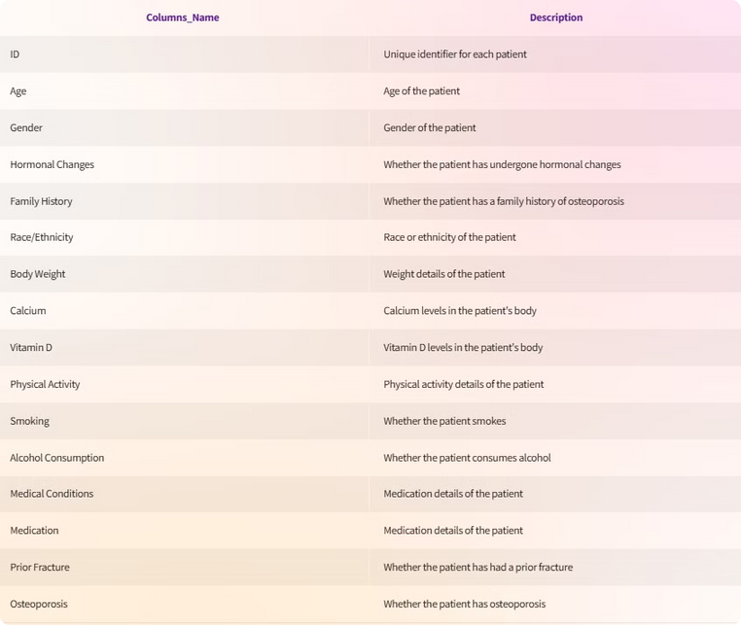


Data Collection
osteoporosis.csv
1958 Rows
16 Columns

Slide 5

Exploratory Data Analysis (EDA)
Exploratory data analysis is a vital step in understanding our dataset.
It is helps in understanding before applying statistical models or machine learning algorithms.
1.Univariate Analysis
2.Bivariate Analysis
→Numerical Variables Univariate Analysis
→Numerical Features vs Target
→Categorical Variables Univariate Analysis
→Categorical Features vs Target

Slide 6

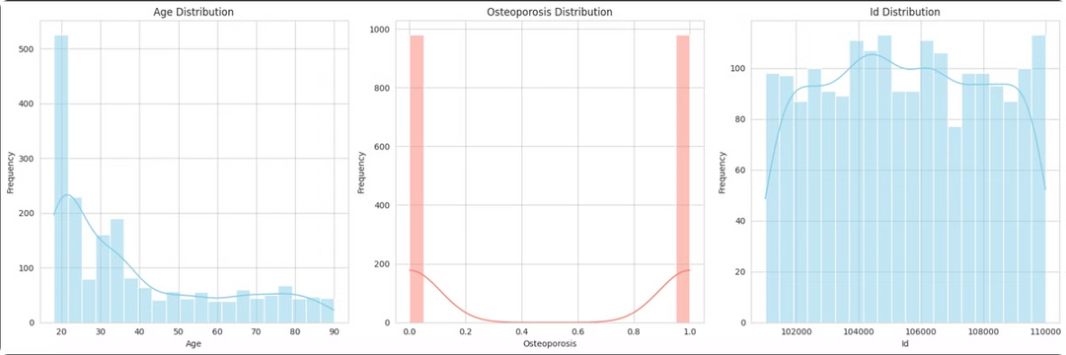
1.Univariate Analysis
Numerical Variables Univariate Analysis
1
Age Distribution (Left Graph)
Most people in the dataset are in their early 20s.
The number of people decreases as age increases.
The data is right-skewed, meaning more young people than older ones.
2
Osteoporosis Distribution (Middle Graph)
The target variable Osteoporosis has two categories: 0 (No) and 1 (Yes).
Both categories have a similar number of records, meaning the dataset is balanced.
The density curve helps visualize how the values are spread.
3
ID Distribution (Right Graph)
The ID column represents unique patients.
The histogram shows an even spread, meaning no missing values
or issues.

Slide 7
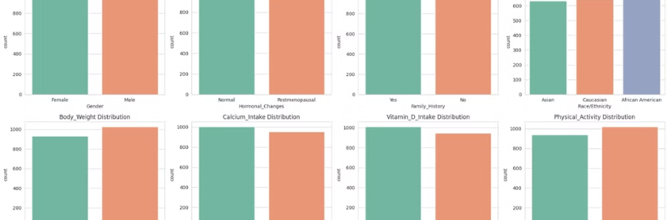
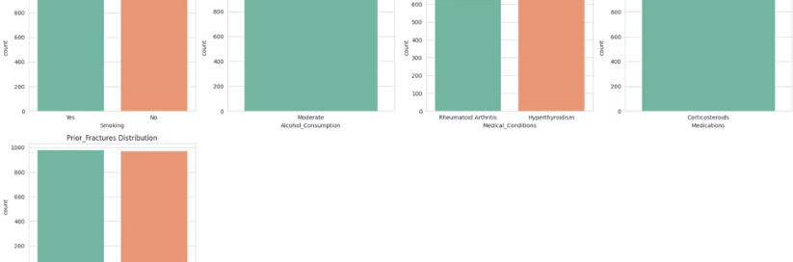
Categorical Variables Univariate Analysis
The bar charts provide insights into the distribution of various categorical features in the dataset. The distributions for Gender, Hormonal Changes, and Family History are fairly balanced, indicating no significant bias in these categories. In contrast, the Race/Ethnicity distribution shows a slightly higher number of African Americans compared to Asians and Caucasians.
Features like Body Weight, Calcium Intake, Vitamin D Intake, and Physical Activity all have two categories with nearly equal distribution, although a few categories have slightly fewer records.
Overall, the dataset appears to be fairly distributed across the different features, which helps ensure a reliable analysis. The Smoking feature has almost the same number of individuals who smoke as those who do not, further reducing any bias.
The Alcohol Consumption feature, however, shows that all records fall under the "Moderate" category, meaning there is no variation in alcohol consumption levels, which could limit its predictive value. The Medical Conditions feature is evenly divided between individuals with "Rheumatoid Arthritis" and "Hyperthyroidism," presenting a fair distribution.
The Medications feature, however, contains only one category, "Corticosteroids," which could reduce its usefulness in prediction. Finally, the Prior Fractures feature is balanced, with an equal number of individuals having and not having prior fractures.

Slide 8

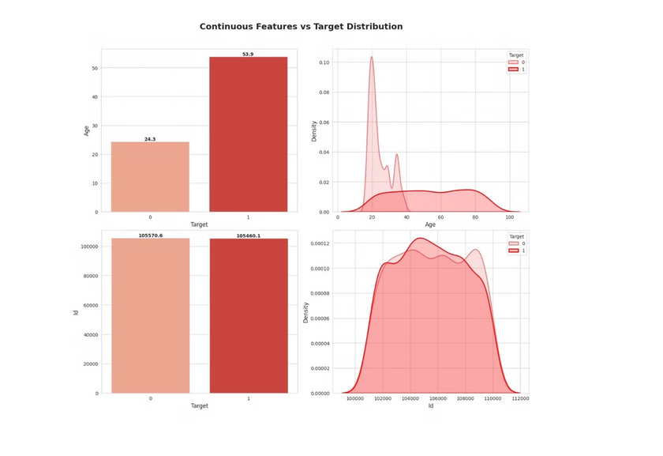
2.Bivariate Analysis
Numerical Features vs Target
This visualization compares the distribution of continuous features (Age and ID) against the target variable (Osteoporosis risk: 0 = No, 1 = Yes).
1.Top Left (Bar Chart - Age vs Target):
The average age for individuals without osteoporosis (Target = 0) is 24.3 years, while for those with osteoporosis (Target = 1), it is 53.9 years.
This indicates that osteoporosis is more common in older individuals.
2.Top Right (Density Plot - Age Distribution):
This plot shows the distribution of age for both target classes.
The density for younger individuals is higher in Target = 0, while for older individuals,
it is higher in Target = 1.
This further confirms that osteoporosis risk increases with age.
3.Bottom Left (Bar Chart - ID vs Target):
The average ID values for both classes are almost identical (105570.6 for Target 0 and 105460.1 for Target 1).
Since ID is just an identifier and has no meaningful relationship with osteoporosis risk, this column can be removed from the dataset.
4.Bottom Right (Density Plot - ID Distribution):
The distribution of IDs is nearly the same for both target classes.
This confirms that the ID column does not provide any useful predictive information.

Slide 9
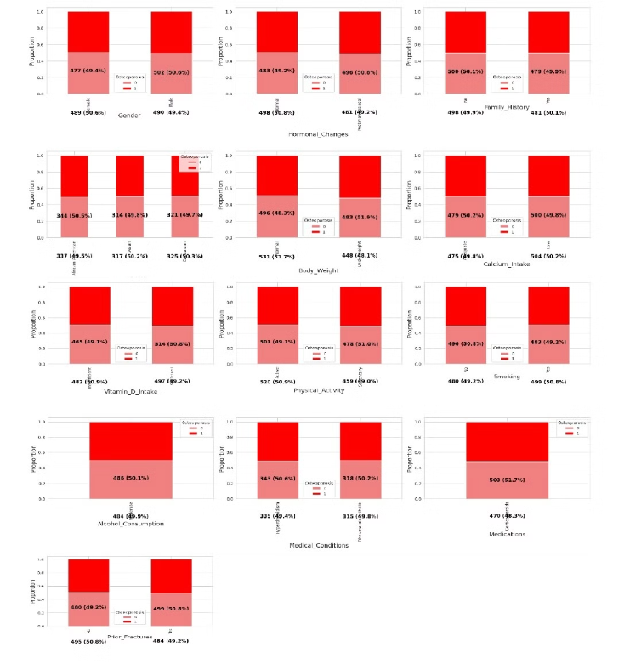
Categorical Features vs Target
The graph shows the relationship between different factors and the presence or absence of osteoporosis. Each bar in the graph represents a different factor, such as gender, hormonal changes, or smoking.
The bars are split into two parts, one representing people with osteoporosis and the other representing people without osteoporosis.
The height of each part of the bar represents the proportion of people with or without osteoporosis in that particular factor group. The graph shows that people with osteoporosis are more likely to be female, have had hormonal changes, have a family history of osteoporosis, and are more likely to have low vitamin D intake and have had prior fractures.
It is also suggested that there might be a higher proportion of people with osteoporosis who are Asian and have a history of high calcium intake, but this should be interpreted with caution as the sample size for these factors is small. The findings from this graph can help to identify people who are at higher risk of developing osteoporosis and guide healthcare providers in their prevention and treatment strategies.

Slide 10

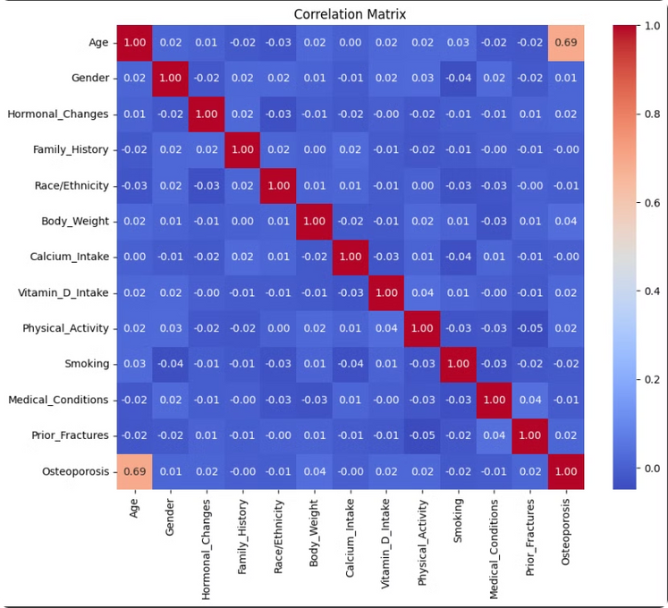
Correlation Heatmap
The heatmap shows the correlation between different features in a dataset.
Red indicates a strong positive correlation: As one feature increases,
the other also increases.
Blue indicates a strong negative correlation: As one feature increases,
the other decreases.
White indicates no correlation: The features are independent of each other.
In this particular heatmap, we can see that there is a strong positive correlation between age and osteoporosis, as well as a strong negative correlation between smoking and physical activity.

Slide 11

Preprocessing
Irrelevant Feature Removal
1
Removed columns that did not contribute meaningful information: 'Id', 'Alcohol_Consumption' & 'Medications'.
2
Handling Missing Values
Missing values replaced with "Unknown". Retained categorical nature of data.
Categorical Feature Encoding
3
Label Encoding applied for compatibility with machine learning models.
4
Outlier Detection and Treatment
Outlier detection conducted using IQR and Z-score methods. No significant outliers found.
Feature Scaling
5
Standard Scaling applied to numerical features (mean=0, standard deviation=1).

Slide 12

Train/Test Split
The data was split into features (independent variables) and the target (dependent variable).
A random state ensures consistent splitting. Stratify=y keeps the original proportion of the target variable in both training and testing sets.
Splitting Data into X & y
The dataset was divided into a training set (80%) and a testing set (30%).
X represents the features, and y represents the target we want to predict.

Slide 13
Model Selection
Models used:
Why Not Select Other Models
Decision Tree: Provides an easy-to-interpret decision-making process and captures non-linear relationships.
Deep Learning models (e.g., Neural Networks) were not used because the dataset size and complexity do not require such high computational power.
Random Forest: Enhances predictive performance by reducing overfitting and provides robust results.
K-Nearest Neighbors (KNN) was avoided because it is sensitive to high-dimensional data and may not generalize well for this problem.
Support Vector Machine (SVM): Works well in high-dimensional spaces and can handle linear and complex decision boundaries.
Logistic Regression: Useful for understanding the direct impact of features on the likelihood of osteoporosis.
Naïve Bayes was not considered as it assumes feature independence, which may not hold true in medical datasets like osteoporosis prediction.
Gradient Boosting: Improves prediction accuracy by sequentially correcting the errors of weaker models.
AdaBoost: Combines weak learners to build a stronger classifier, improving overall model performance.

Slide 14

Model Performance Summary
•This slide provides a summary of key metrics and confusion matrices for evaluating the performance of 6 machine learning models .
Precision: Represent how many of actual positive cases are actually positive.
Recall: Represent how many of actual positive cases were correctly predicted by model.
F1 Score: A balance between recall and precision, useful when both false positives and false negatives need to be minimized.
Model
Accuracy
Precision
Recall
F1 Score
Gradient Boosting(GRB)
0.92
0.93
0.92
0.92
AdaBoost(ADB)
0.92
0.93
0.92
0.91
Decision Tree(DT)
0.90
0.92
0.91
0.90
Random Forest(RF)
0.85
0.87
0.86
0.86
Support Vector Machine(SVM)
0.85
0.87
0.85
0.85
Logistic Regression(LR)
0.82
0.82
0.82
0.82

Slide 15

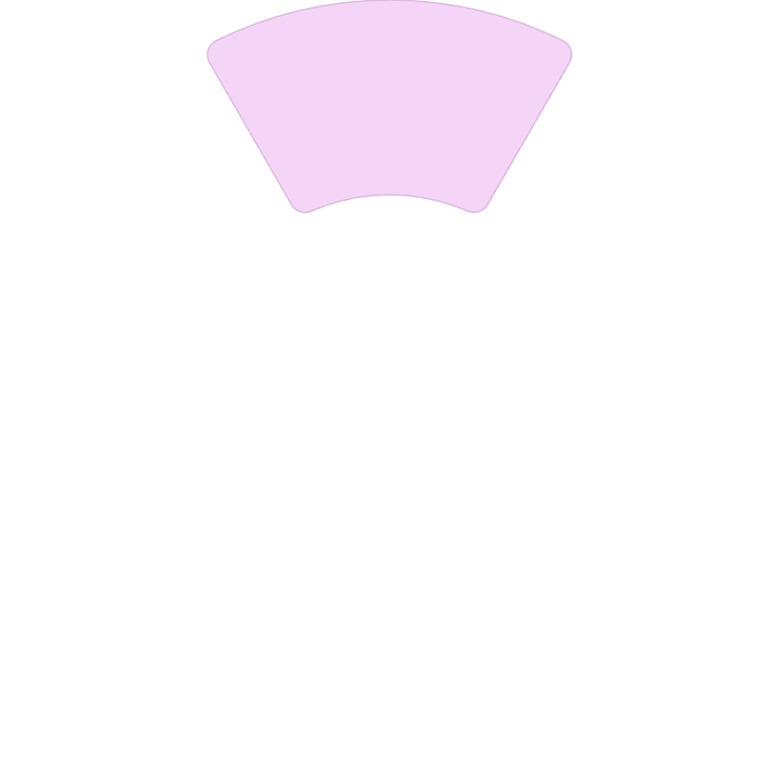

Conclusion
This project shows the effectiveness of machine learning. These models predict osteoporosis risk. It enables proactive health measures. Early detection is key to better outcomes.
Key Factors
Osteoporosis risk is influenced by age, hormonal changes, nutrition, lifestyle factors (e.g., smoking, physical activity), medical conditions, and family history. These factors play a crucial role in determining bone health and fracture risk.
High Accuracy
The best model is Gradient Boosting (GRB) as it has the highest Precision (0.93), Recall (0.92), F1-score (0.92), and Accuracy (0.92), making it the most balanced and reliable choice. It effectively minimizes false positives and false negatives, ensuring strong overall performance. AdaBoost (ADB) is a close second with slightly lower F1-score (0.91) but can be a good alternative if a lighter model is needed. 🚀
Future research
For future research, integrating deep learning techniques, real-time patient monitoring, genetic markers, and bone density scan data could enhance prediction accuracy. Additionally, developing personalized treatment plans based on risk levels can improve early intervention and patient care.
2
1
3

Slide 16

Thank You
Thank you for your attention. This is a crucial step. Predicting osteoporosis risks is beneficial. Early detection allows for timely intervention.
Our machine learning models provide good accuracy. They identify individuals at higher risk. Proactive healthcare is essential.
We hope this research helps improve bone health.

